Slide 1


Smart braking system
Theme Laboratory Project
Team: Holdjáró szárnyakkal

Slide 2
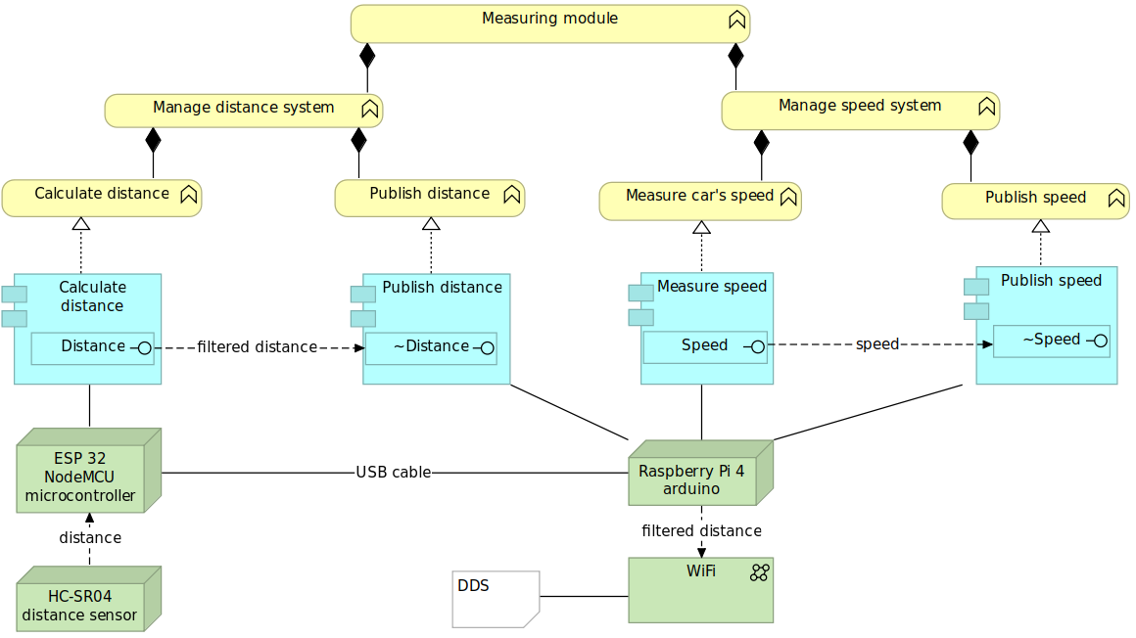
Measuring module
Roles:
Collecting data
Filtering data
Distributing data via DDS
DDS:
Communication middleware in CPS
Publish – Subscribe with Topics
Common network

Slide 3
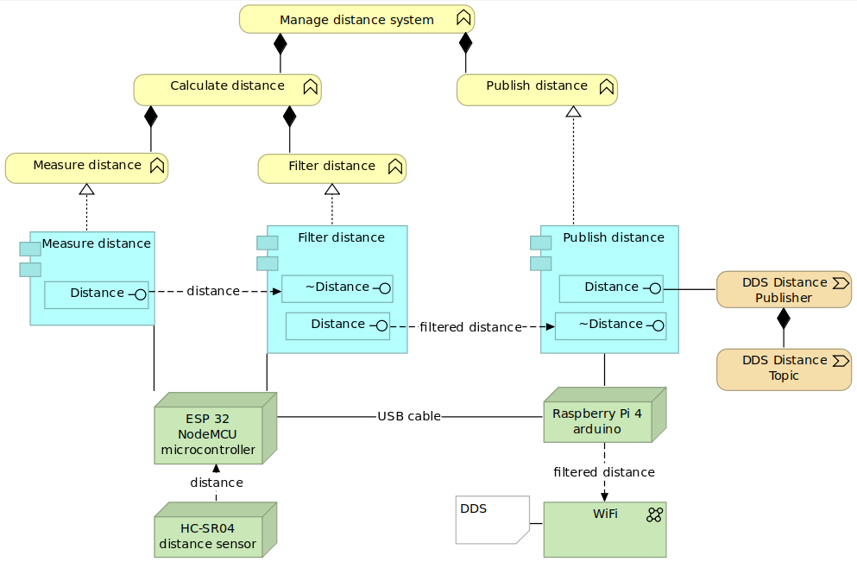


Distance system
Operating sensor
Calculate distance
Filtering algorithm
Serial port communication
Distance Topic
Distance Publisher

Slide 4
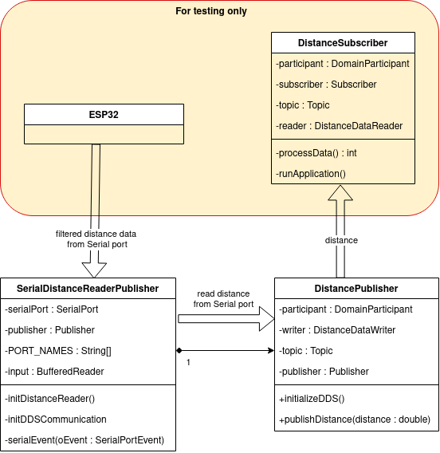
Data flow I.

Slide 5
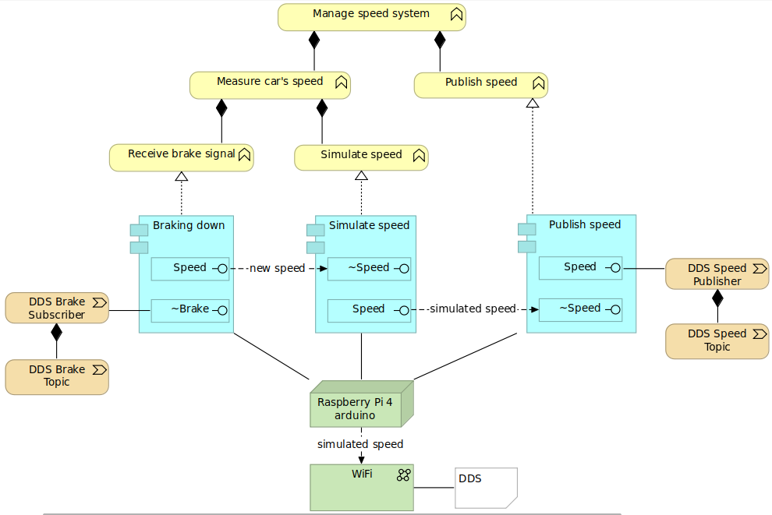
Speed system
Speed simulation
Brake Topic
Brake Subscriber
Speed Topic
Speed Publisher
Emergency Shutdown signal
Reset signal

Slide 6
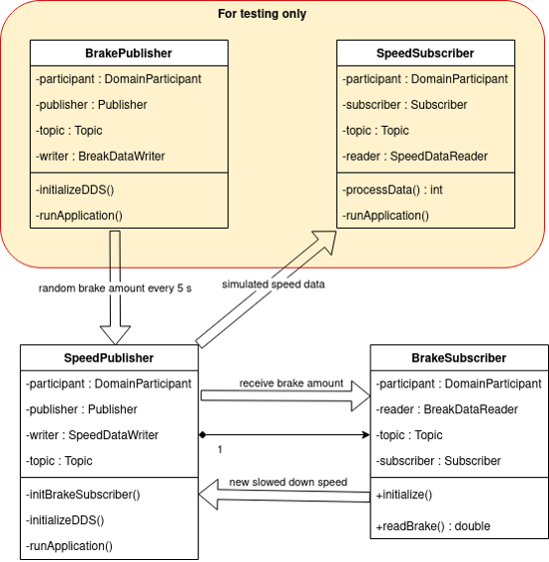
Data flow II.

Slide 7
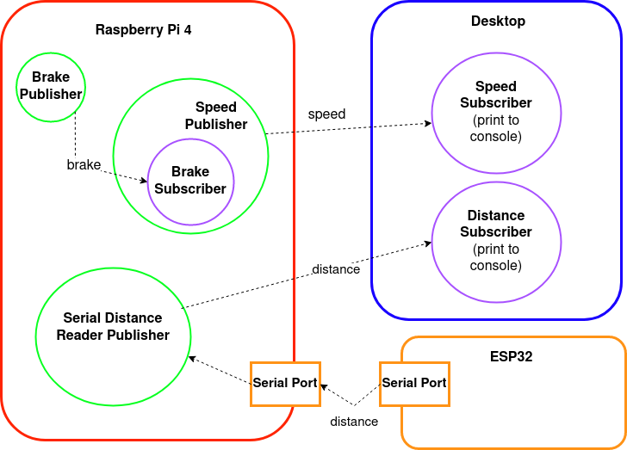
Measuring module data flow
Local desktop development
RasPi 4 migration
Testing
Learned new skills, technologies:
Linux
Microcontrollers
DDS
LaTeX

Slide 8
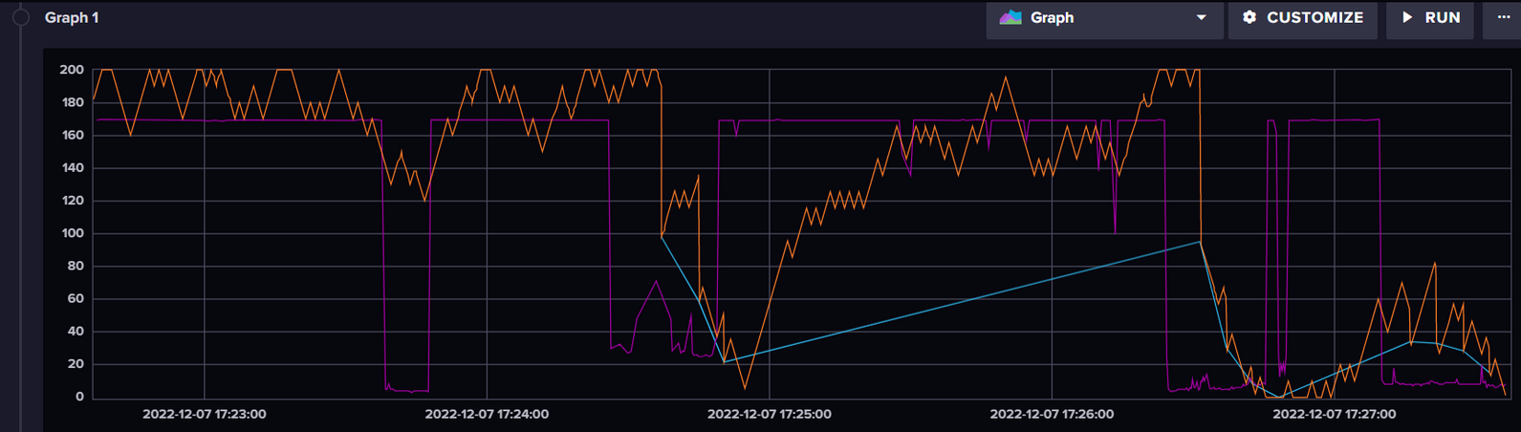
Smart braking system integration
Orange: Car's current speed
Purple: Distance from object in front
Blue: Braking amuont

